Slide 1
Training on classification to outperform human perceptual similarity
인공지능팀 인턴 김수용
The Unreasonable Effectiveness of Deep Features as a Perceptual Metric
Richard Zhang1 Phillip Isola12 Alexei A. Efros1 1UC Berkeley 2OpenAI
{rich.zhang, isola, efros}@eecs.berkeley.edu
Eli Shechtman3 Oliver Wang3 3Adobe Research {elishe,owang}@adobe.c

Slide 2
Abstract
Solution
Trouble
- Underlying process of human
- Classic metric
Result
- Various networks
- Various supervise situation

Slide 3

Train on
Classification
Train on
New Dataset
Deep Features as New Metric

Slide 4
Motivation
Trouble
1. High dimensional, high correlation, subjective
2. Bad classic metrics → Unable to evaluate structured image
3. Context dependent & Pairwise nature

Slide 5
Motivation
Solution
1. Internal activations of deep convolutional networks, though trained on a high-level image classification task, are often useful
2. Features from networks have been used on tasks → Measuring distance in feature space as a perceptual loss
3. New large database of human judgments

Slide 6
Conclusion
Activation & calibration == Human perceptual judgments
Better than classic metrics
Good performance regardless of supervise cases

Slide 7
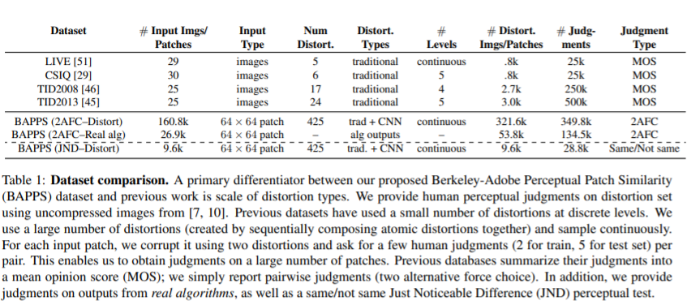
Dataset Settings
Distortions
Real algorithm outputs
Richer
Human Judgments
Focus on perceptual similarity

Slide 8
BAPPS Dataset

Slide 9
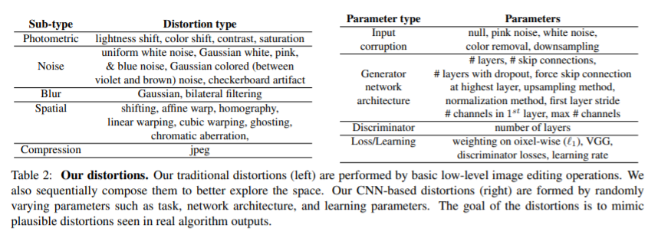
Distortions
Traditional
- 5 types
Parametrized severity
20 distortions and 308 sequential distortions
2. CNN-based
5 types
New idea
3. Real algoristhm output
Super-resolution
Frame interpolation
Video deblurring
Colorization

Slide 10
2AFC
JND
Perceptual metrics
Judgments
Evaluate
Distortions

Slide 11
Deep Features

Slide 12
Network architectures
VGC
5 Conv layers
AlexNet
Similar to human visual cortex
Conv1-Cov5 layers
SqueezeNet
Lightweight
Similar to AlexNet
Cosine distance
Average across spatial dimensions and layers
How to tune an existing network

Slide 13
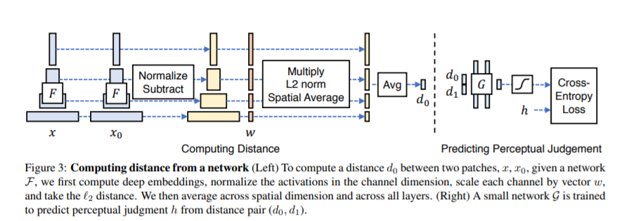

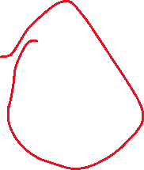




Slide 14
Network activations to distance : F
Compute Deep Embedding
Distance between two patches
Normalize
Activations
Scale each channel by Vector w
L2 Distance
Average across spital dimension & all layers

Slide 15
Train on new data
Lin
Keep pre-trained networks weights ‘F’ fixed
Learn weights ‘w’ on top
Tune
Initialize from a pre-trained classification model
Initialize the net work from random Gaussian weights
Scratch
Perceptual calibration
Allow all the weights for network ‘F’ to be fine-tuned
Train entirely on our judgments

Slide 16
Experiments

Slide 17
p ^2 + (1 − p) ^2
x0 & x1

Slide 18
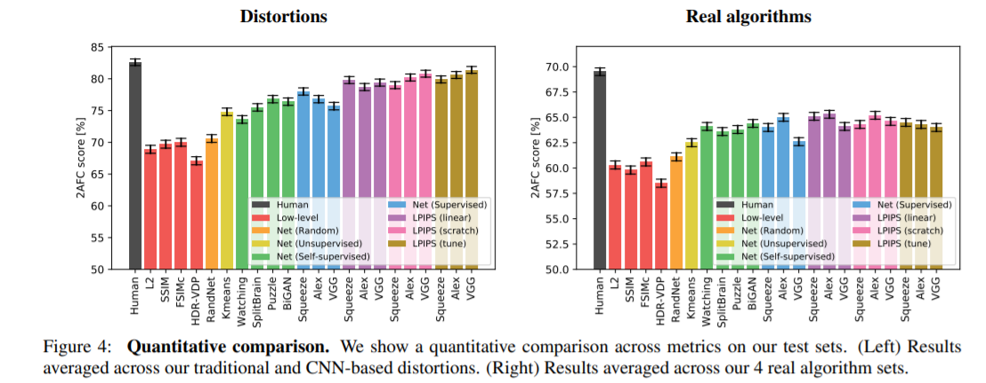
성능
향상
Various tasks
Tune
네트워크결합
Capacity
Calibrate
Learn a linear
Conclusion
Better than low metric
Networks can learn from perceptual judgments
Distortions project onto judging real algorithms
Starting with a pre-trained network and tuning throughout lowers transfer performance
Evaluations

Slide 19
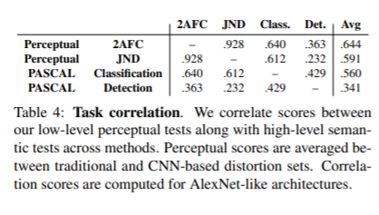
Evaluations
How well perceptual task correlates to semantic tasks(classification) on PASCAL dataset
The correlation from 2AFC distortion to classification and detection is .640 and .363
Correlation between the classification and detection tasks is .429
The 2AFC distortion preference test has high correlation to JND: ρ = .928

Slide 20
Conclusion
Goal
Achievement
Predicting hard vision
&
Modeling task
Learning a representation of the world that correlates well with perceptual judgments
Train
여러 supervise 목표에 대해 train 된 network 는 semantic task 에서도 효과적
Network 가 분류 , detection 을 더 잘할수록 perceptual similarity judgment 도 더 잘한다
이 논문은 생물학적 인식 특성(사람)이 nature assignment 를 해결하려는 rational agent 의 result 일 수 있다는 가능성을 보임

